Slide 1


Slide 2

VIT
Topic/Course
Sub-Topic (Example: name of college)

Slide 3

Compound Interest

Slide 4

Compound Interest
Compound Interest Definition:
Compound interest is the interest calculated on the principal and the interest accumulated over the previous period. It is unlike simple interest where interest is not added to the principal while calculating the interest during the next period. Compound interest finds its usage in most of the transactions in the banking and finance sectors and also in other areas as well. Some of its applications are:
Increase or decrease in population.
The growth of bacteria.
Rise or depreciation in the value of an item.

Slide 5
Compound Interest
Compound Interest Formula:
The compound interest formula is given below:
Compound Interest = Amount – Principal

Slide 6
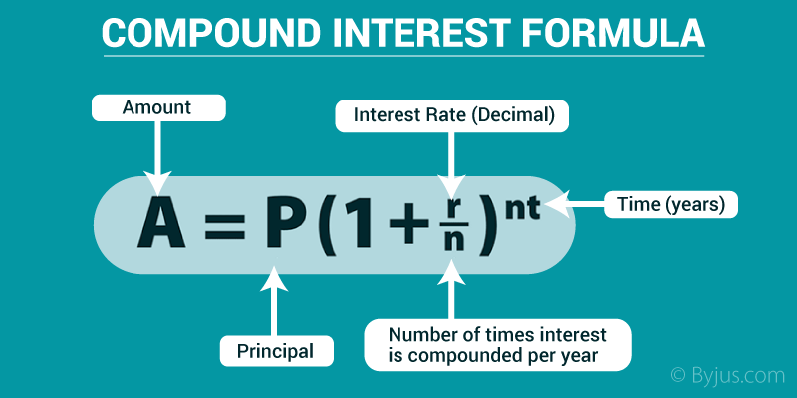
Compound Interest
Where the amount is given by:

Slide 7
Compound Interest
Where,
A= amount
P= principal
R= rate of interest
n= number of years
It is to be noted that the above formula is the general formula for the number of times the principal is compounded in an year. If the amount is compounded annually, the amount is given as-
A=P(1+(R/100))^{t}

Slide 8
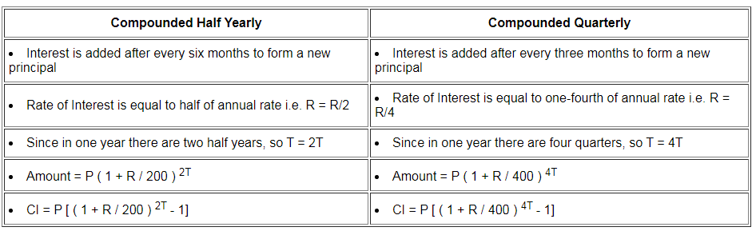
Compound Interest
If interest is not compounded yearly then,

Slide 9
Question 1
Find the compound interest on Rs.8000 at 5% per annum for 3 years when C.I is reckoned yearly.
A)
Rs. 1262
B)
Rs. 1261
C)
Rs. 1260
D)
Rs. 1361
Notes:
Answer: B
Formula for CI=P(1+R/100)^{n} - P C= 8000(21/20)³ - 8000 CI= 9261 - 8000= 1261

Slide 10
Question 2
A sum is invested at compound interest payable annually. The interest in the first two successive years was Rs. 400 and Rs. 420. The sum is ______________.
A)
Rs. 8000
B)
Rs. 7500
C)
Rs. 8500
D)
Rs. 6500
Notes:
Answer: A
This means that, simple Interest on Rs.400 for 1 year = 420 - 400 = 20 Rate = (100×SI)/PT= (100×20)/400×1 = 5% Rs. 400 is the interest on the sum for 1st year Hence, Sum = (100×SI)/RT= (100×400)/5×1= Rs. 8000

Slide 11
Question 3
At what rate percentage per annum will Ron lends a sum of $ 2000 to Ben. Ben returned after 2 years $ 2205, compounded annually?
A)
2%
B)
3%
C)
4%
D)
5%
Notes:
Answer: D
Let the required rate be R% per annum. Here, A = $ 2205, P = $ 2000 and n = 2 years. Using the formula A = P(1 + R/100)ⁿ, 2205 = 2000 × ( 1 + R/100)² ⇒ (1 + R/100)² = 2205/2000 = 441/400 = (21/20)² ⇒ ( 1 + R/100) = 21/20 ⇒ R/100 = (21/20 – 1) = 1/20 ⇒ R = (100 × 1/20) = 5%

Slide 12
Question 4
Find the compound interest on Rs. 500 for 1 year at 40% per annum compounded quarterly.
A)
Rs. 146.01
B)
Rs. 133.1
C)
Rs. 732.50
D)
Rs. 232.05
Notes:
Answer: D
A = P(1 + R/100)^n A = 500(1+40/400)4 = Rs. 732.05 CI = Rs. 732.05 - Rs. 500 CI = Rs. 232.05

Slide 13
Question 5
The annual sales of a company in the year 2000 was Rs. 1000 and in the year 2005 was Rs. 2490. Find the compounded annual growth rate of sales in the given period of the same company.
A)
14.28%
B)
125%
C)
17.86%
D)
20%
Notes:
Answer: D
This question could be solved with a basic assumption.From the question it is clear that, the interest amount = (2490-1000) = 1490Assumed interest amount = 1490/5 = 295 Since this is compound interest the interest amount will be greater than the previous years interest amount.Therefore let us assume the first years interest amount = 200
So the rate of interest should 20% or 0.2
When n=1, 20%(1000) = 200
20%(1200) = 240
20%(1440) = 288
20%(1728) = 345.6
20%(2073.6) = 414.72
Total Interest amount = 1488.32 approximately 1490
Therefore it is clear that rate of interest = 20%

Slide 14
Question 6
What is the amount after 3 years on a sum of Rs. 15638 being compounded annually at interest of 10% per annum ?
A)
Rs. 20814
B)
Rs. 19824
C)
Rs. 21924
D)
Rs. 19784
Notes:
Answer: A
Amount after ‘n’ years is: P[ 1 + (r/100)]^n = 15638 [1 + (10/100)]^3 Hence, Amount = 15638[1.1]^3 Amount = Rs. 20814

Slide 15
Question 7
Ram purchased a Hyundai car 3 years ago for Rs. 0.4 million. Its value depreciated each year @ 20% p.a. What is the present value of the car?
A)
691200
B)
241800
C)
204800
D)
24800
Notes:
Answer: C
Since 20% deducted = 1/5 is deducted every year 1/5 (400000) = 80000 1/5 (320000) = 64000 1/5 (256000) = 51200 value = (256000-51200) = 204800

Slide 16
Question 10
Reena got a loan of Rs. 12000 against her fixed deposits to purchase a mobile phone. If the rate of interest is 12% p.a. compounded half yearly, then the amount (in Rs.) that she has to pay back after 2 years is _______.
A)
24883
B)
13483
C)
18882
D)
15149
Notes:
Answer: D
Since compounded half yearly, r% = 12%/2 = 6% n=1, 6%(12000) = 720 n=2, 6%(12720) = 763.2 n=3, 6%(13483) = 808.96 n=4, 6%(14292) = 857.52 Amount at the end of two years = (14292+857.52) = 15149

Slide 17
Question 11
The effective annual rate of compound interest corresponding to a compound interest of 8% per annum payable half-yearly is ___________.
A)
8.16%
B)
6.16%
C)
7.16%
D)
5.16%
Notes:
Answer: A
Assume P = Rs. 100
A = 100 ( 1 + 4 / 100 )²
= 100 * 1.0816 =108.16
I=108.16-100=8.16%

Slide 18
Question 12
The amounts for compound interest on a certain sum at a certain rate of interest after the second and third year are Rs. 19860 and Rs. 21846, respectively. What is the rate of interest?
A)
10%
B)
20%
C)
30%
D)
40%
Notes:
Answer: A
(P[1+R/100]^3)/(P[1+R/100]^2) = 21846/19860 [1+R/100] = [1 + (1986/19860)] R = 10% Alternate Method: The difference between the two compound interest of any two consecutive years will be same as the interest on the amount of total previous years. So, 21846 - 19860 = 1986 Therefore, R = 1986/19860 = 10%

Slide 19
Question 13
Pravin borrowed a sum of money and returned it in three equal quarterly instalments of Rs. 17576 each. Find the sum borrowed, if the rate of interest charged was 16% per annum compounded quarterly.
A)
46900
B)
48775
C)
68320
D)
44556
Notes:
Answer: B
Image: View->Notes page

Slide 20
Question 14
Mr. Venu invests Rs. 20000 in an account that pays 4% interest per year, compounded quarterly. What is the amount of money that he will have after 2 years?
A)
21657.12
B)
20282.52
C)
22802.56
D)
22028.58
Notes:
Answer: A
Since compounded quarterly, r%/4 = 1% for two years = interest should be calculated 8 times n = 1, 1%(20000) = 200 n = 2, 1%(20200) = 202 n = 3, 1%(20402) = 204.02 n = 4, 1%(20606.02) = 206.06 n = 5, 1%(20812.08) = 208.12 n = 6, 1%(21020.2) = 210.20 n = 7, 1%(21230.4) = 212.30 n = 8, 1%(21442.7) = 214.42 amount = (21442.7+214.42) = 21657.12

Slide 21
Question 15
A certain amount of money is lent out at compound interest at the rate of 40% per annum for two years, compounded annually. It would give Rs. 568 more if the amount is compounded half yearly. The principal is Rs. ______.
A)
10000
B)
12000
C)
6000
D)
5000
Notes:
Answer: D
C.I. = [p ( 1 + r / 100 )^{n]} - p [for yearly C.I.]C.I. = [p ( 1 + r /2* 100 )^{2n}] - p [for half yearly C.I.]
A/Q,
Assume principal amount = Rs. P
P[( 1.2 )⁴ - (1.4)² ] = 568
P [ 0.1136 ] = 568
P = Rs. 5000

Slide 22
Question 16
The death rate of a town with a population of 5000 is 20%. Considering that there are no new births, what is the population of town after 3 years?
A)
1280
B)
3600
C)
2560
D)
2780
Notes:
Answer: C
Decreased Population = P (1 - R/100)^n = 5000(1- 20/100)³ = 2560

Slide 23
Question 17
Kishore invests Rs. 3000 for three years at a certain rate of interest, compounded annually. At the end of one year it amounts to Rs. 3540. Calculate the amount due at the end of the second year.
A)
4035.6
B)
4071
C)
4080
D)
4177.2
Notes:
Answer: D
P = 3000 I = (3540-3000) = 540 r%(P) = 540 r/100 * (3000) =540 r = 54/3 r = 18% second year interest amount = 18%(3000+540) = 637.2 Amount at the end of second year = 3540+637.2 = 4177.2

Slide 24
Question 18
A bank offers 10% compound interest calculated on half-yearly basis. A customer deposits Rs. 1000 each on 1st January and 1st July of a year. Find the interest he would have gained at the end of a year.
A)
Rs. 2152.50
B)
Rs. 152.50
C)
Rs. 1152.50
D)
Rs. 315
Notes:
Answer: B
At the end of June, interest obtained = 50. Amount = 1000 + 50 = 1050 Now, he invests 1000 more. New principal = 1000 + 1050 = 2050 At the end of the year, interest = 5% of 2050 = 102.50 A = 2050 + 102.50 = Rs. 2152.50 Total I = A - P = 2152.5 - 2000 = Rs. 152.50 Alternate Method: Amount after 1 year on Rs. 1600 (deposited on 1st Jan) at 5% when interest calculated half-yearly = P(1+(R/2)/100)^2T =1600(1+(5/2)/100)^2×1 =1600(1+1/40)^2 Amount after 1/2 year on Rs. 1600 (deposited on 1st Jul) at 5% when interest calculated half-yearly = P(1+(R/2)/100)^2T = 1600(1+(5/2)/100)^2×1/2 =1600(1+1/40) Total Amount after 1 year = 1600(1+1/40)^2 + 1600(1+1/40) = 1600(41/40)^2 + 1600(41/40) = 1600(41/40) [1 + 41/40] = 1600 (41/40)(81/40) = Rs. 3321 Compound Interest = Rs.3321 - Rs.3200 = Rs.121

Slide 25
Question 19
The population of goats in a village was 5200 three years back. It is 6600 right now. What will be the population three years down the line, if the rate of growth of population of goats is constant over the years?
A)
6400
B)
8000
C)
8800
D)
6600
Notes:
Answer: C
Before three years population was 5200 Present population is 6600 The rate of growth = (1400/5200) x 100 = 33.33% or 1/3 Since rate of growth is constant, the population growth after three years = 1/3 (6600) = 2200 The population after three years = 6600 + 2200 = 8800

Slide 26
Question 20
A sum of Rs. 10,000 is divided between 2 siblings who are 5 and 6 years old in such a way that if their portions are invested at the rate of 2% per annum compound interest, they shall receive equal amounts on reaching 18 years of age. How much money does the younger one get initially?
A)
4000
B)
4950
C)
4735
D)
4335
Notes:
Answer: B
The number of years the money will be invested for both the siblings are 13 and 12 years respectively.
The principal 10,000 is divided between the two.
Let their individual principals be X and Y
X is older one’s principal and Y is younger one’s principal
X+Y=10,000
R=2
n1=12
n2=13
X(1+R/100)^{n1}=Y(1+R/100)^{n2}
X(1.02)¹²=Y(1.02)¹³
X=1.02Y
X+Y=10,000
1.02Y+Y=10,000
Y=10,000/2.02
Y=4950

Slide 27

THANK YOU

